Slide 1






Crafts-Connect
EMPOWERING RURAL ARTISANS AND PRESERVING CULTURAL HERITAGE THROUGH SUSTAINABLE E-COMMERCE
PRESENTED BY:
RESHMA R - 210701212
SANJAY S - 210701231
SHRIRAM KUMAR A N - 210701247
SOWMIYA S - 210701255

Slide 2

ABSTRACT
India is a land rich in cultural heritage, where the artistry and craftsmanship of skilled artisans have flourished for centuries.
Crafts-Connect is a digital marketplace that supports rural artisans and producers by showcasing their products globally.
Our platform promotes sustainable business, preserves cultural heritage and promotes livelihoods through skills development.
It promotes eco-friendly practices, community support and supports traditional working practices, making a positive impact on the lives of artisans and cultural preservation traditions.

Slide 3

OBJECTIVES
Traditional craftsmanship startups play a vital role in preserving cultural heritage by reviving ancient techniques and art forms that are at risk of being forgotten.
Providing rural artisans with a global platform to showcase and sell their traditional products, expanding their market reach beyond local communities.
Enable artisans to earn fair wages and sustainable incomes through direct sales, fostering economic stability and improving quality of life.
Promote eco-friendly production practices and sustainable sourcing of raw materials, ensuring that traditional crafts are produced in harmony with the environment and contribute to environmental conservation efforts.

Slide 4
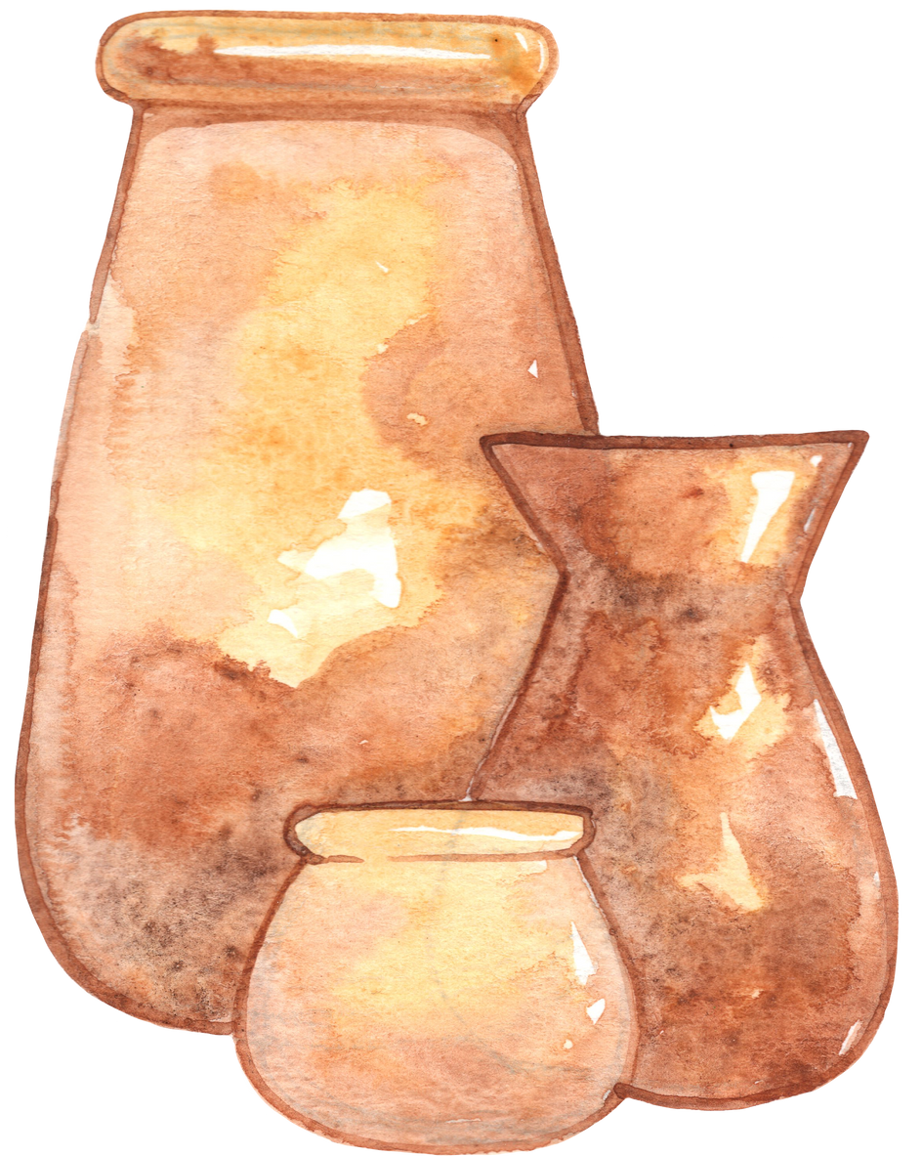
PROBLEM STATEMENT
In the face of globalization, the preservation of traditional crafts is paramount for cultural heritage and rural livelihoods.
Our mission is to develop an innovative digital platform that combines tradition with modern commerce and supports rural artisans and ceramic makers around the world.
Our goal is to preserve traditional crafts and support rural artisans.
Our digital platform connects artisans to global markets, ensuring fair wages and economic stability.
Combining tradition with innovation, we protect cultural heritage and support rural communities for sustainable development.

Slide 5
EXISTING SYSTEM
Existing solutions for supporting rural artisans and marketing traditional products include general e-commerce platforms, specialized marketplaces, social enterprise initiatives, government programs, and nonprofit organizations.
However, they may not fully address the unique needs of rural artisans or provide comprehensive solutions for economic sustainability and cultural heritage preservation.
A new platform could integrate elements of these existing systems while innovating to provide tailored support and a holistic approach to rural artisan development.

Slide 6

PROPOSED SYSTEM
Crafts-Connect, our proposed platform, seeks to revolutionize the traditional craft industry by providing a global marketplace for rural artisans and pottery makers.
Through Crafts-Connect, artisans can showcase their unique products to a global audience, ensuring economic sustainability.
By encouraging community engagement and celebrating traditional craftsmanship, Crafts-Connect preserves cultural heritage.
This platform seeks to be a catalyst for positive change in the traditional craft industry, connecting artisans with opportunities and consumers with authentic, culturally rich products.

Slide 7

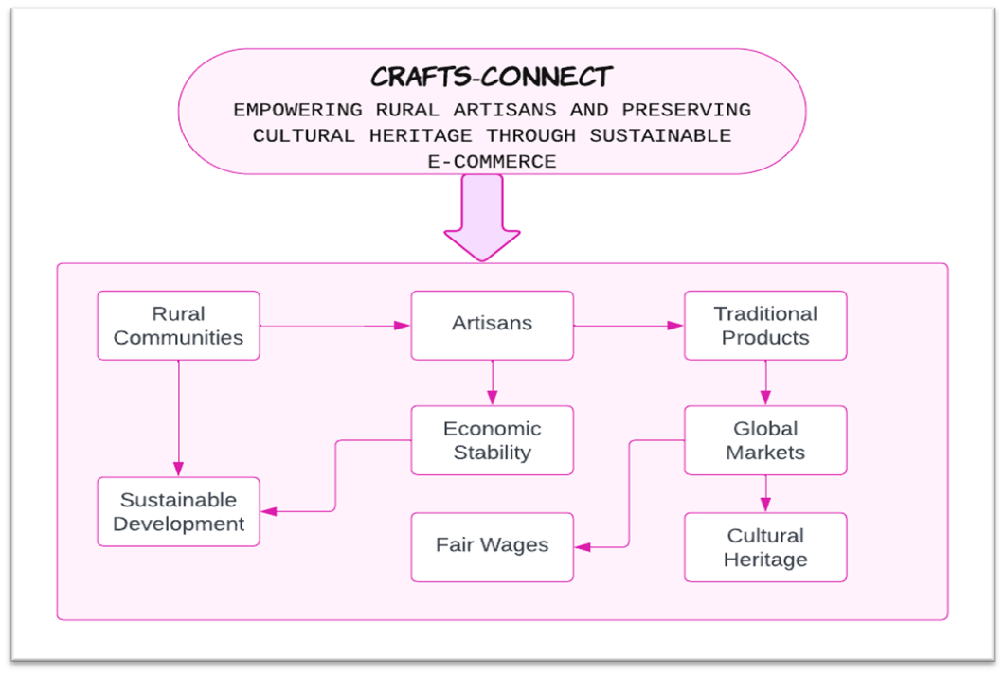

SYSTEM ARCHITECTURE

Slide 8

TECH STACK
HTML & CSS
JavaScript
React JS
Node.js
Express
MongoDB

Slide 9
MODULES
SIGN UP AND LOGIN
User
Artisan
Products
Search and Filter
Cart

Slide 10
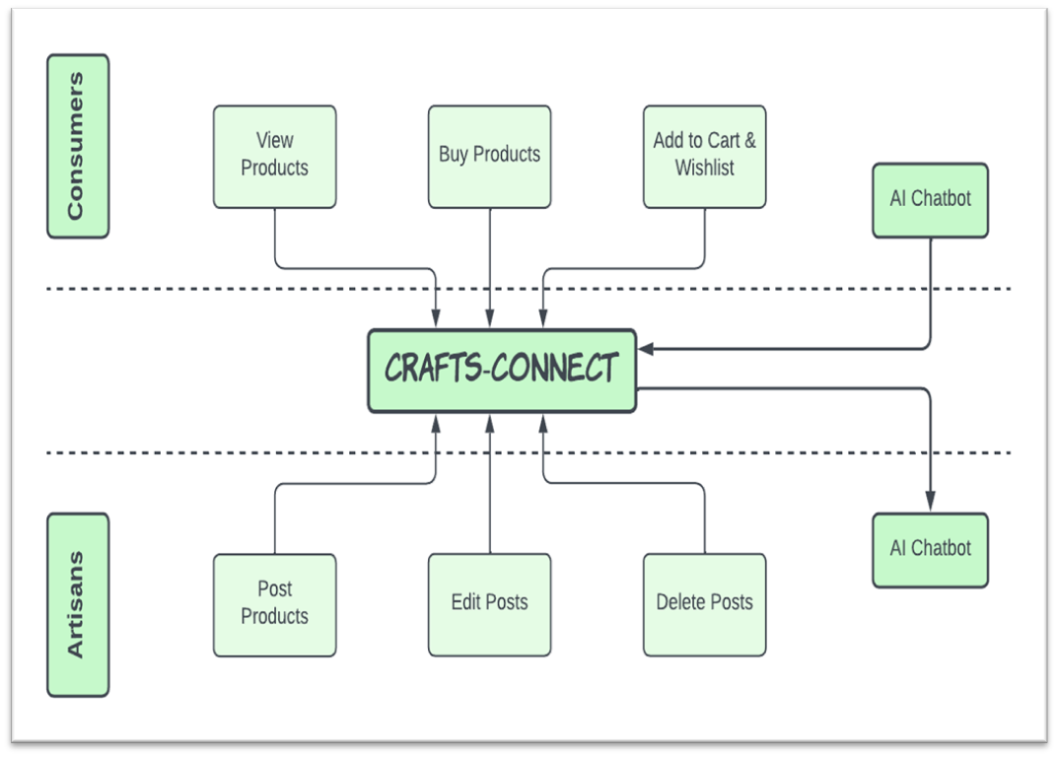
MODULE DESCRIPTION

Slide 11
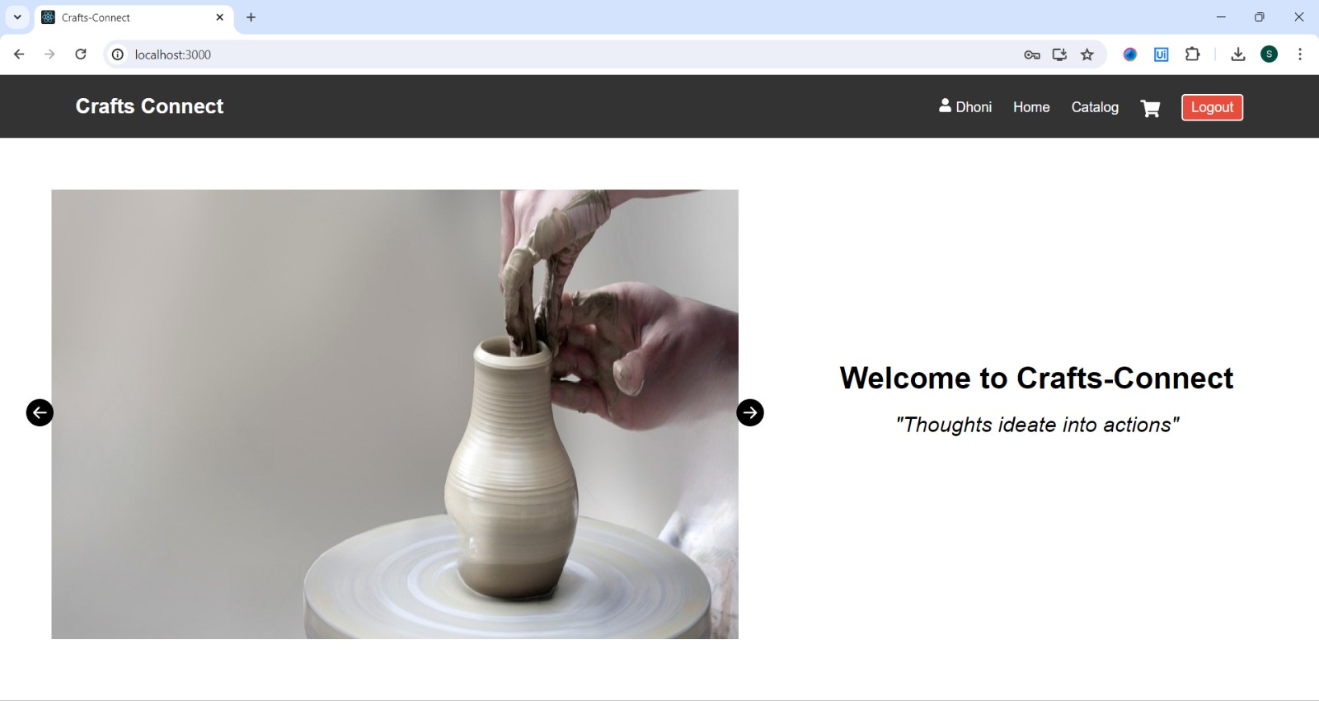
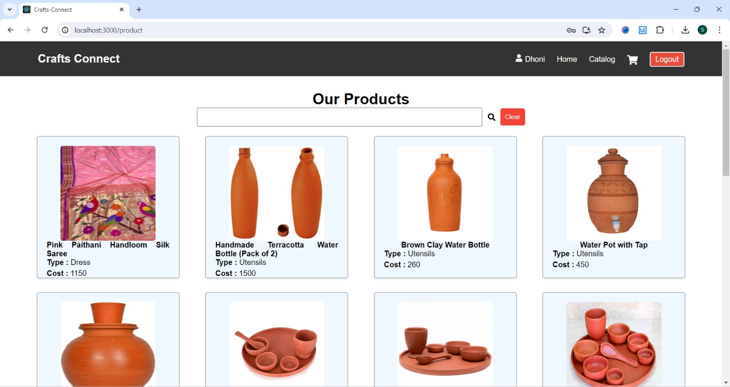
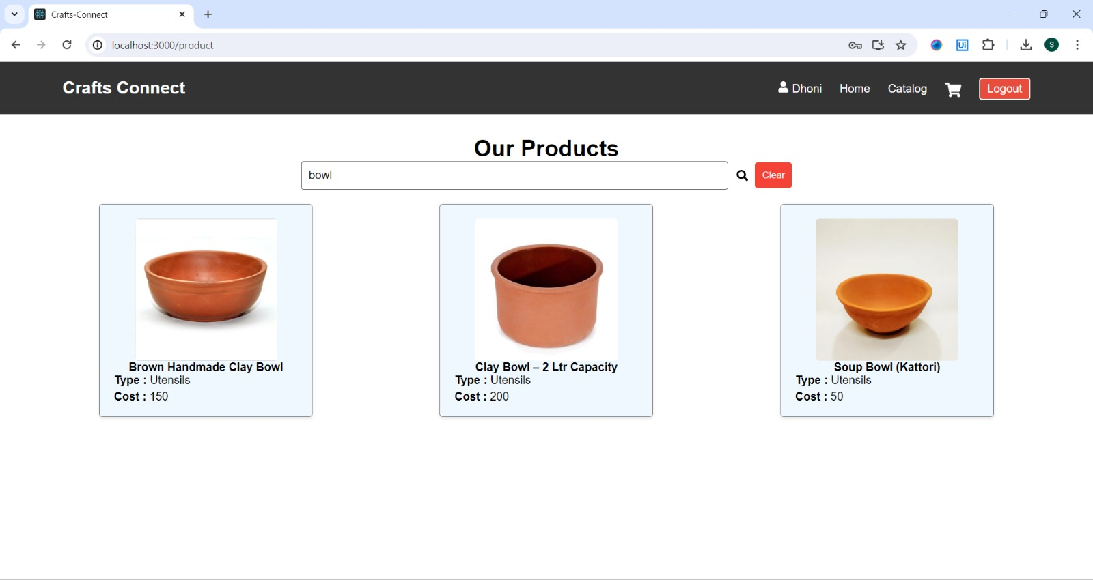
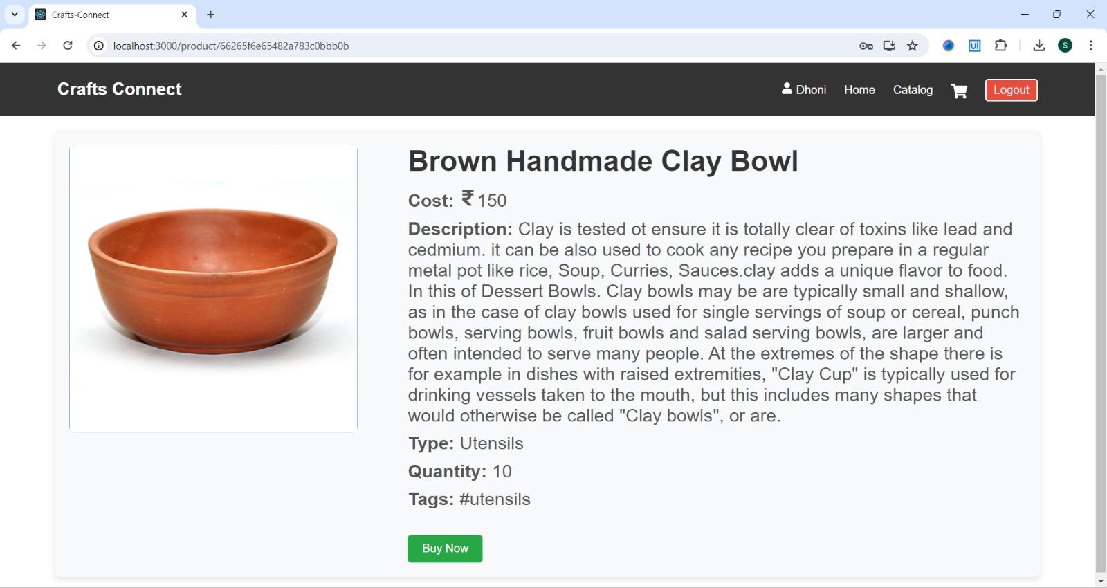
OUTPUT SCREENSHOTS

Slide 12
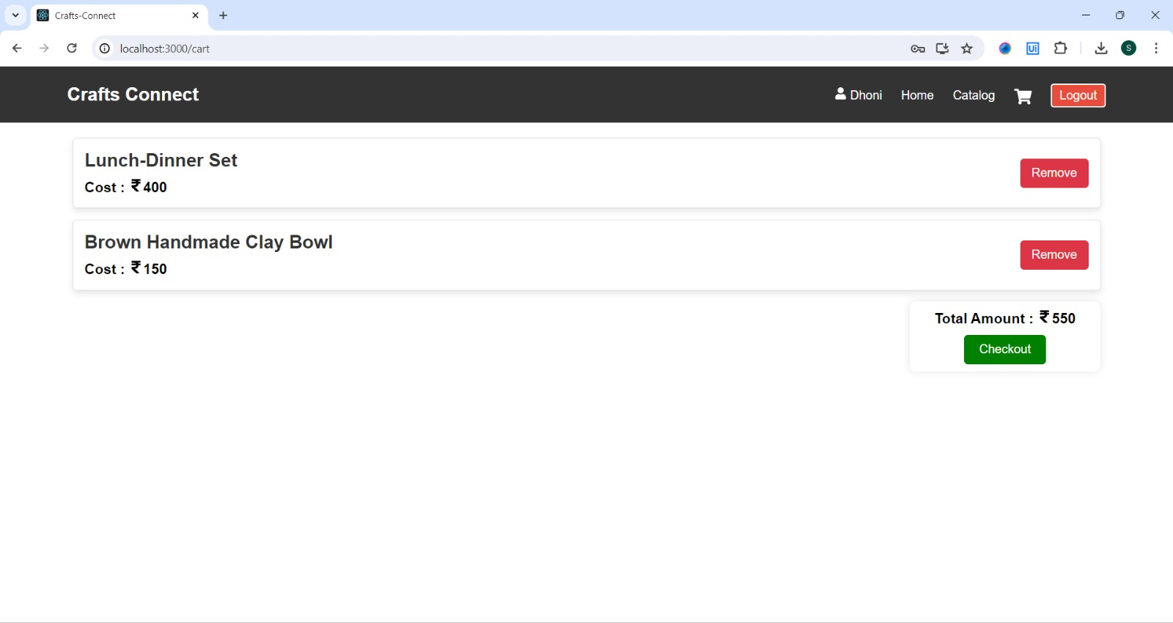
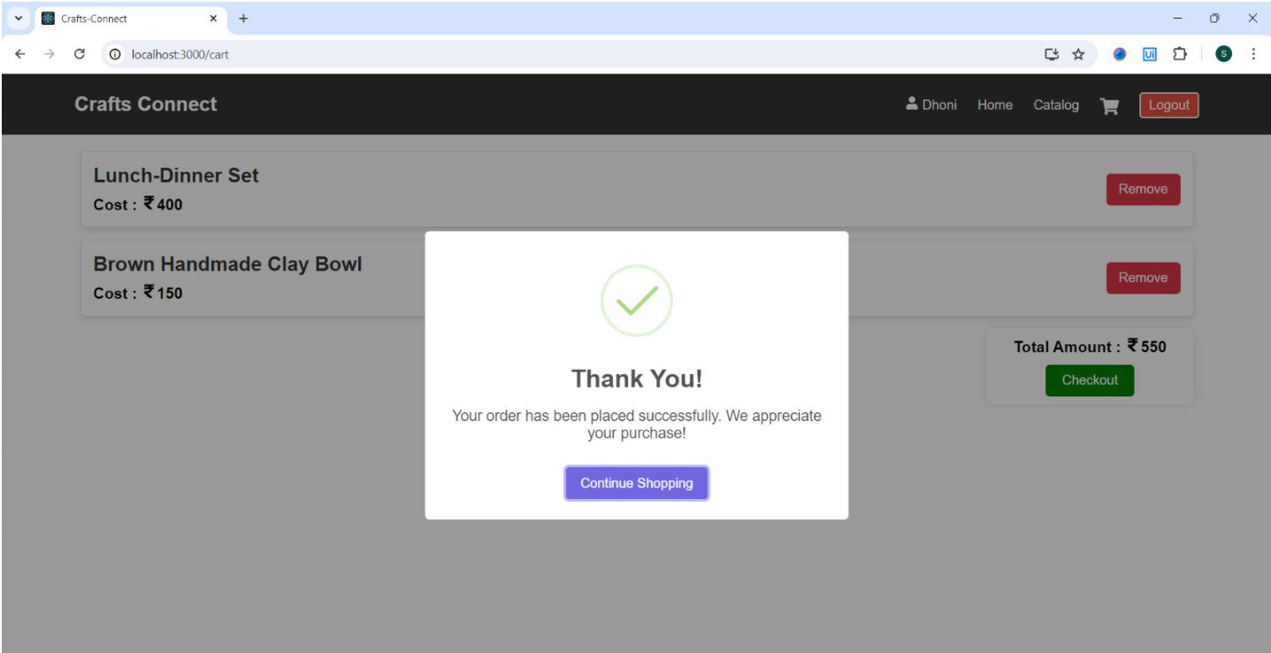
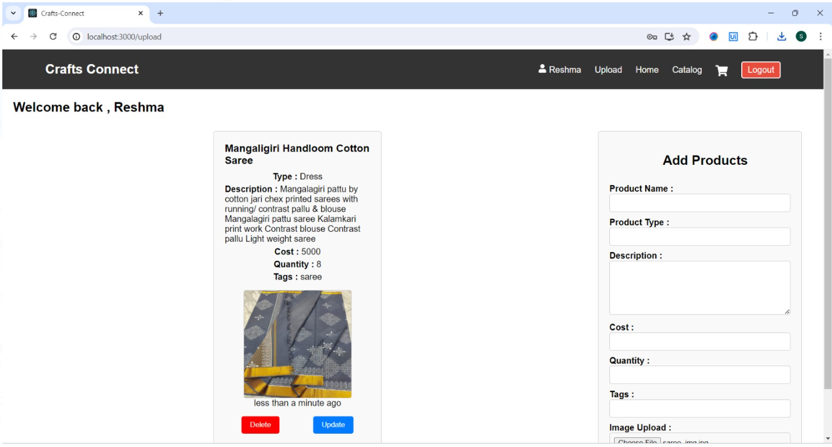
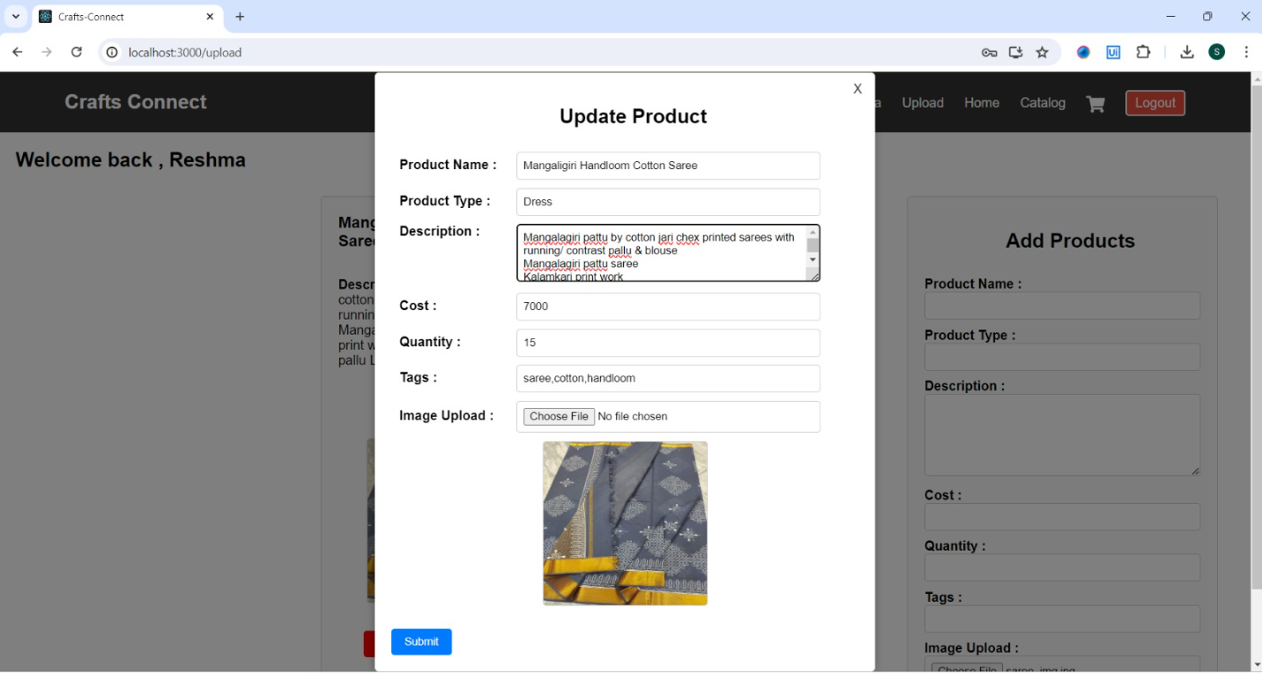
OUTPUT SCREENSHOTS

Slide 13
CONCLUSION
Crafts-Connect significantly empowers rural artisans by providing them access to a global market, thereby enhancing their livelihoods and helping to break the cycle of poverty.
The platform plays a crucial role in preserving ancient crafting techniques and revitalizing forgotten skills, fostering cultural pride and continuity.
Through its eco-friendly practices, Crafts-Connect promotes environmental conservation, ensuring a sustainable future for artisans and their communities.
By strengthening local economies and encouraging cross-cultural understanding, it fosters a global appreciation for the beauty of craftsmanship.
Future enhancements include adding multilingual support to the chatbots, enabling seamless global communication between artisans and customers.

Slide 14
REFERENCES
Almamari, B., 2020. Investigating Omani Artisans’ Skills in Marketing their Creative Manufactured Goods. Saudi Journal of Humanities and Social Sciences, 5(9), pp.466-469.
Curkovic, M.D., 2021. The role of the traditional crafts as intangible heritage on the global tourist market. In SHS Web of Conferences (Vol. 92, p. 06005). EDP Sciences.
De Silver, G. and Kundu, P., 2013. Handicraft products: Identify the factors that affecting the buying decision of customers (The Viewpoints of Swedish Shoppers).
Wallace, J., 2014. Handmade 2.0: women, DIY networks and the cultural economy of craft (Doctoral dissertation, Concordia University).
Shah, A. and Patel, R., 2017. Problems and challenges faced by handicraft artisans. Voice of Research, 6(1), pp.57-61.

Slide 15
REFERENCES
Gulati, V. and Mathur, S., 2017. Digital manufacturing of Indian traditional handicrafts. International Journal of Computer Applications, 164(11), pp.1-4.
Farhikhteh, S. and Farhikhteh, F., 2013. Studying the role of using electronic commerce in development of handy-woven carpet exports compared to using the traditional methods. African Journal of Business Management, 7(25), p.2444.
Halbe, A., 2023. Trademarks of Tradition: Artisan Labor, Development and Place Making in Rural India. University of California, Los Angeles.
Huang, T. and Anderson, E., 2019. Designing for revitalization of communities through new business models for traditional arts and crafts. Art and Design Review, 7(04), p.225.
Jena, P.K., 2008. Globalization of Indian handicrafts: A human development approach. Orissa review, 65, pp.19-25.

Slide 16
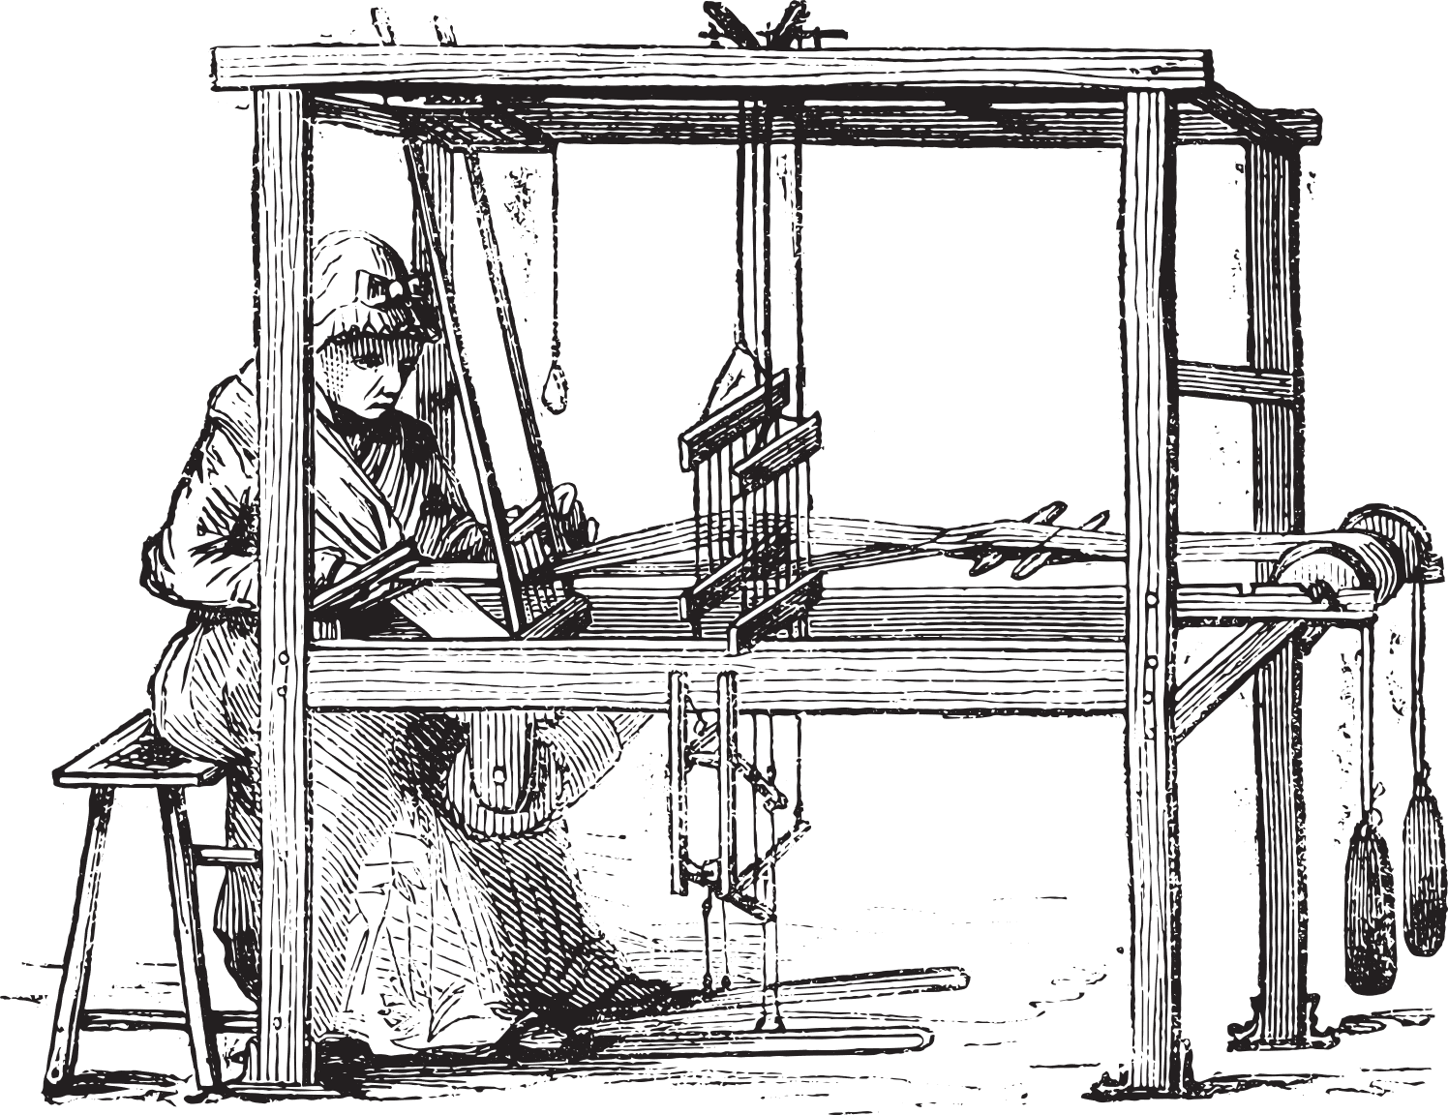
Thank You

